Slide 1
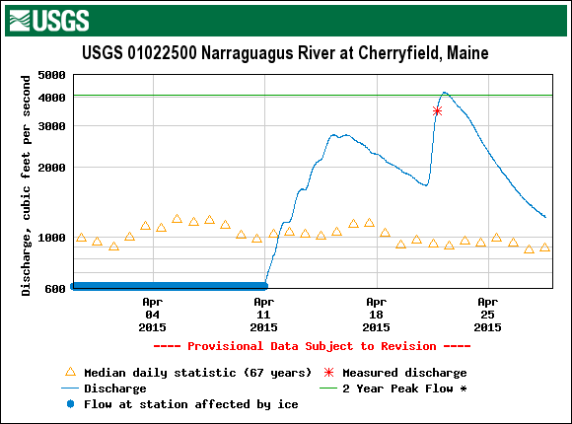
Photo Album & Time Lapse Video
Max 4,190
April 22
4:15-7:00 AM
Green Line= 2 year recurrence Interval
Narraguagus River
Ice Control Dam
Cherryfield, Maine
Scott Craig Certified Fisheries Professional
Project Leader/ Fishery Biologist
Maine Fishery Resources Office
306 Hatchery Road
East Orland, Maine 04431
Office: 207 469-6701 ext. 226 Cell: 207 240-3172 Fax: 469-6725
http://www.fws.gov/northeast/mainefisheries/

Slide 2
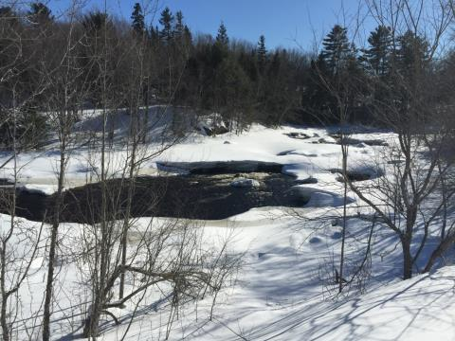
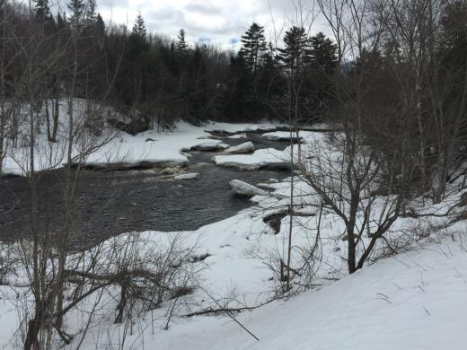
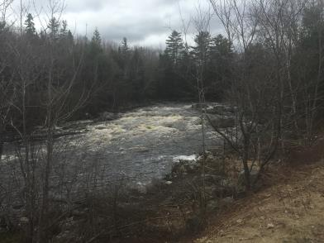
March 27, 2015
Looking upstream at road junction going to Dam and RR Bridge
April 28, 2015
March 31, 2015

Slide 3
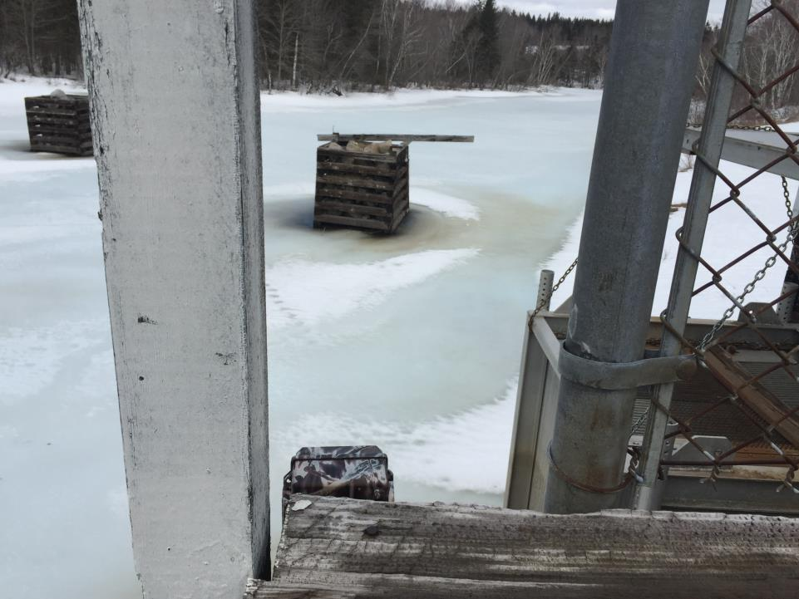
Camera looking upstream on Dam
March 31, 2015

Slide 4
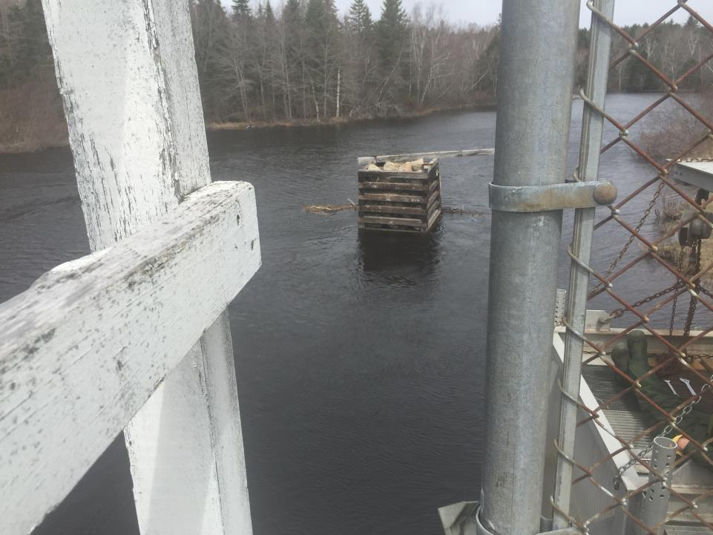
Camera looking upstream on Dam
April 28, 2015

Slide 5
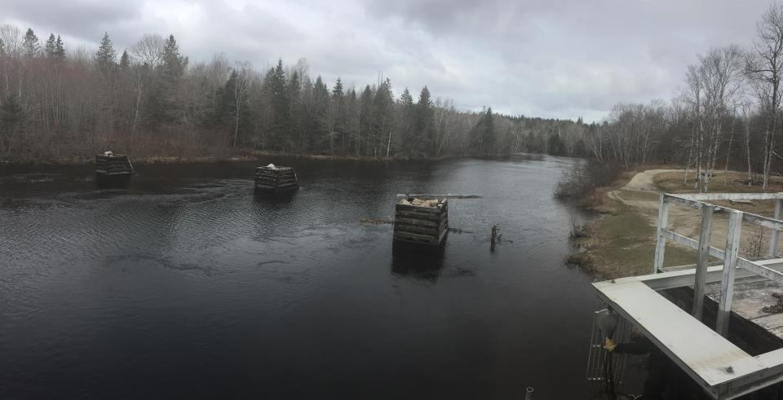
Camera looking upstream on Dam
April 28, 2015

Slide 6
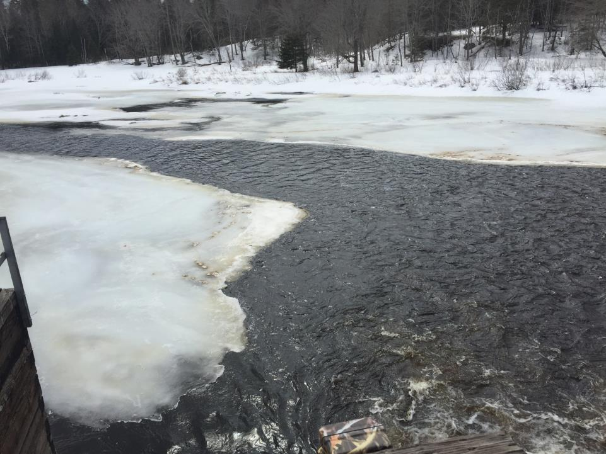
Camera looking downstream on Dam
March 31, 2015

Slide 7
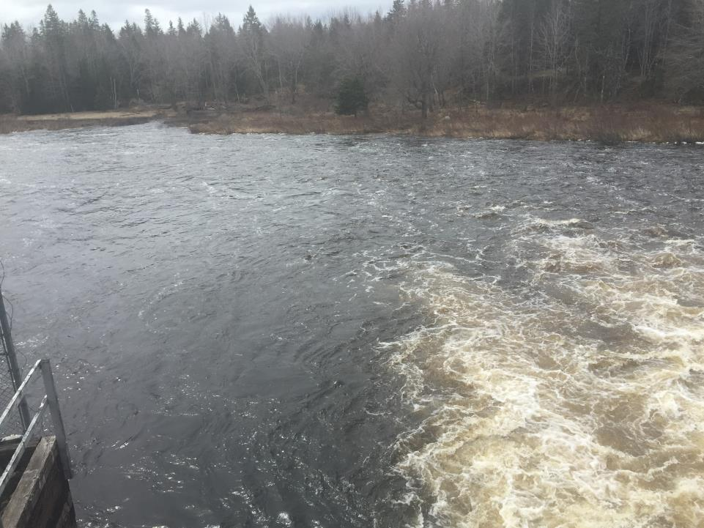
Camera looking downstream on Dam
April 28, 2015

Slide 8
Camera looking downstream on Dam
April 28, 2015

Slide 9
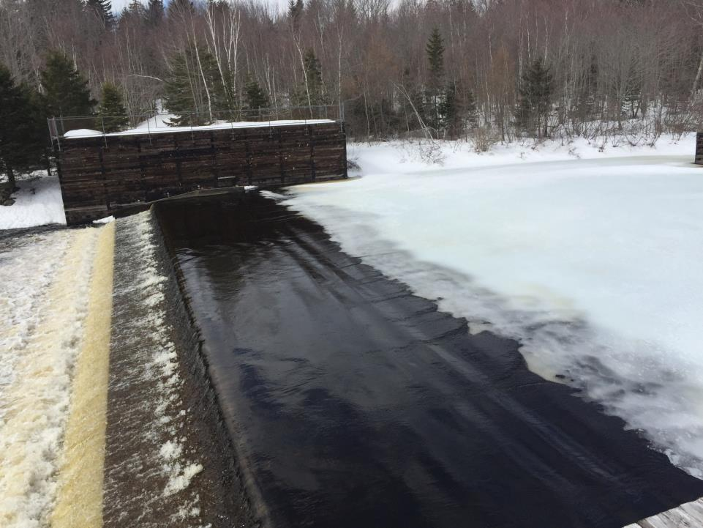
March 31, 2015

Slide 10
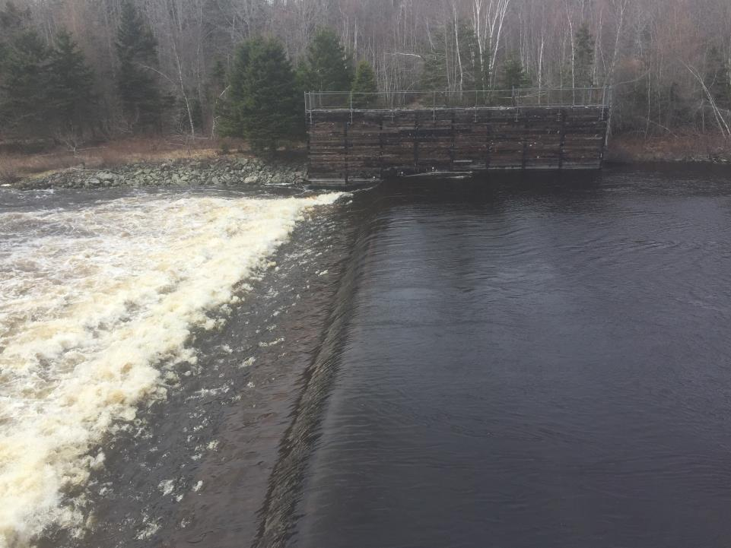
April 28, 2015

Slide 11
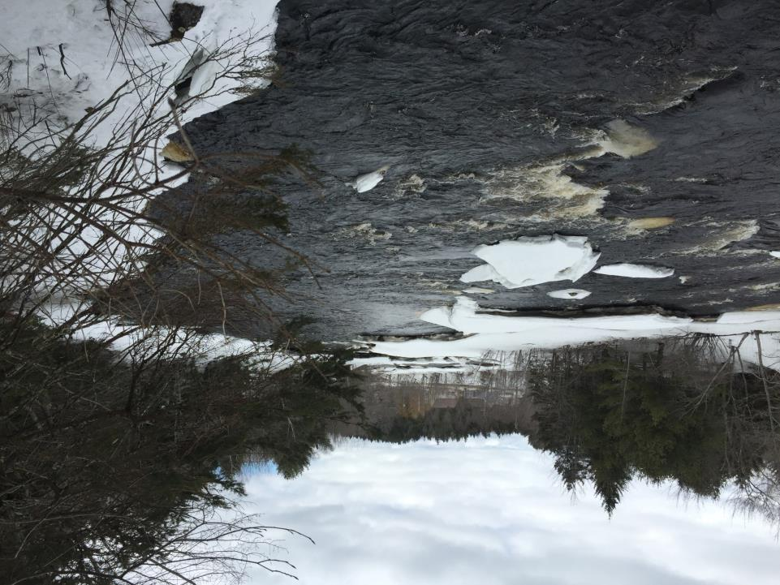
Camera looking downstream from RR Bridge
March 31, 2015

Slide 12
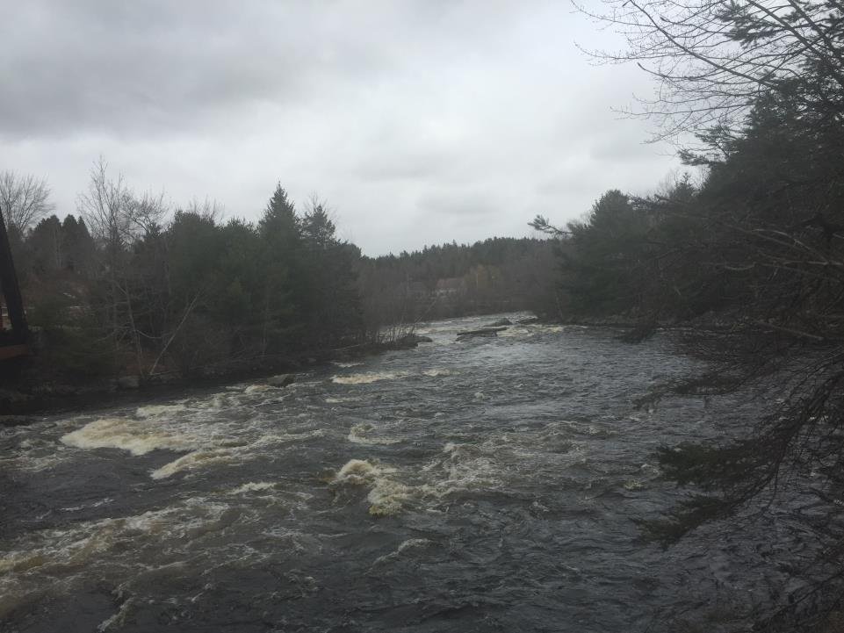
Camera looking downstream from RR Bridge
April 28, 2015

Slide 13
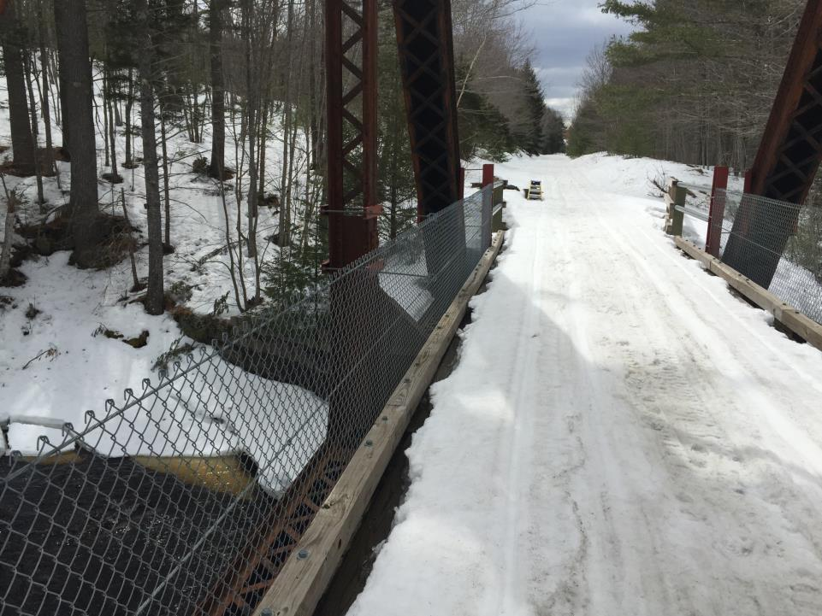
Camera in Tree
March 31, 2015

Slide 14
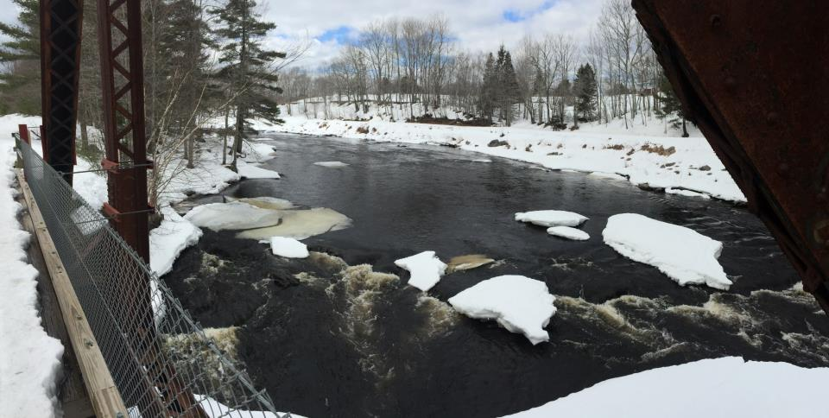
Looking upstream from RR Bridge
March 31, 2015

Slide 15
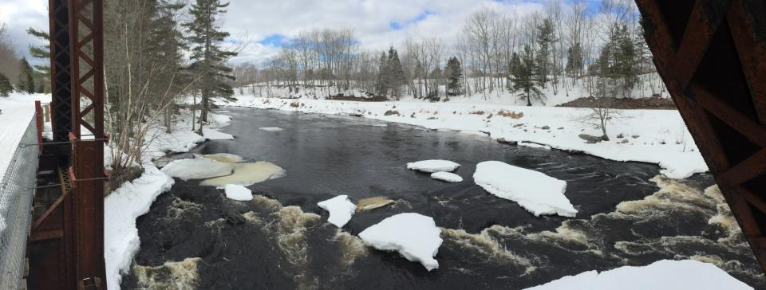
Looking upstream from RR Bridge
March 31, 2015

Slide 16
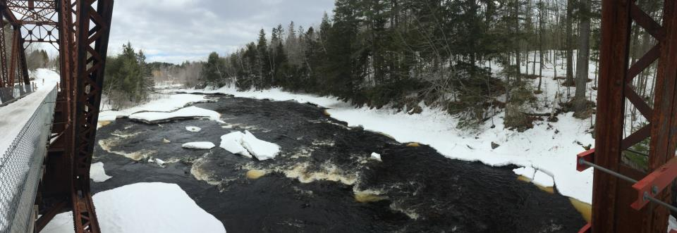
Looking downstream from RR Bridge
March 31, 2015

Slide 17
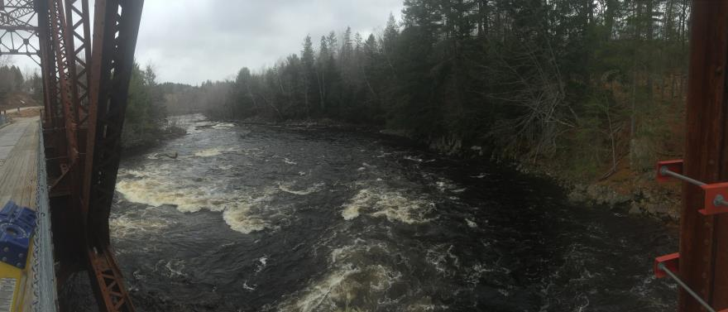
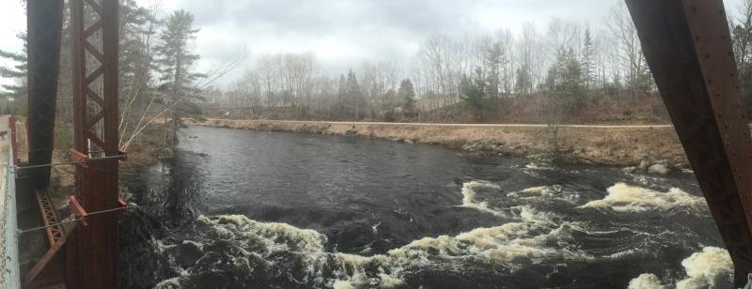
At RR Bridge
April 28, 2015

Slide 18
Camera in tree looking downstream in Veterans Park- Cherryfield
March 31, 2015

Slide 19
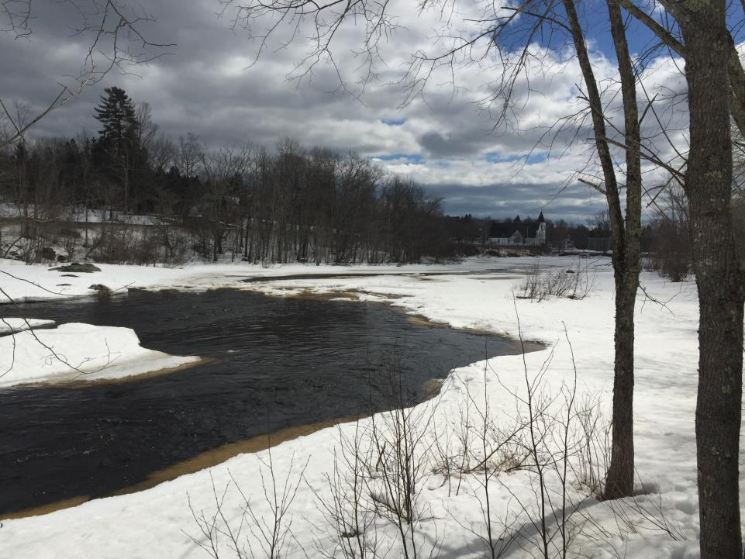
Camera in tree looking downstream in Veterans Park- Cherryfield
March 31, 2015

Slide 20
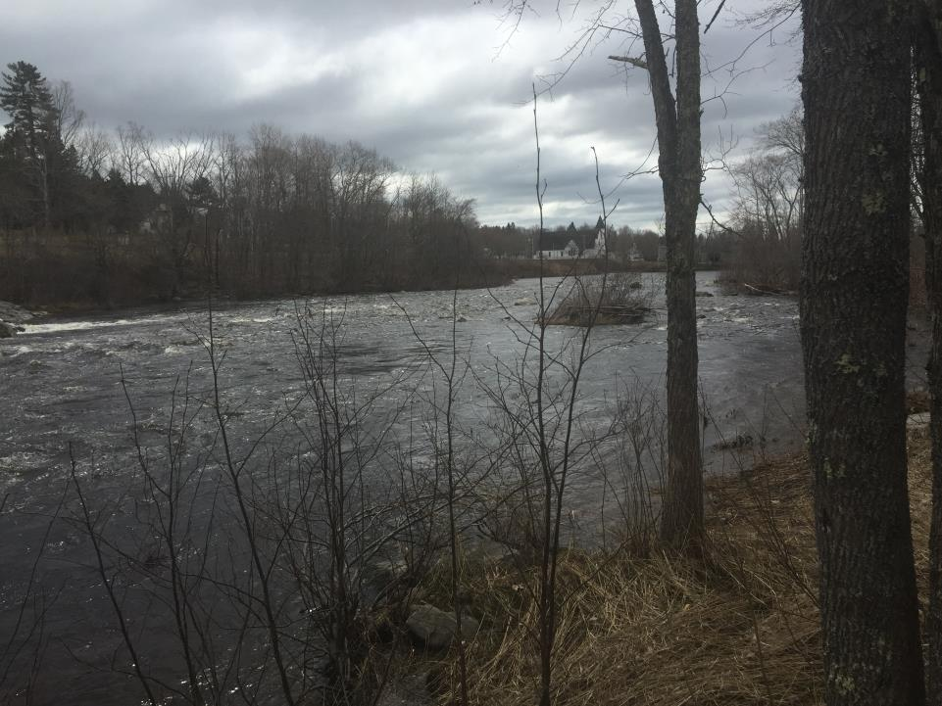
Camera in tree looking downstream in Veterans Park- Cherryfield
April 28, 2015

Slide 21
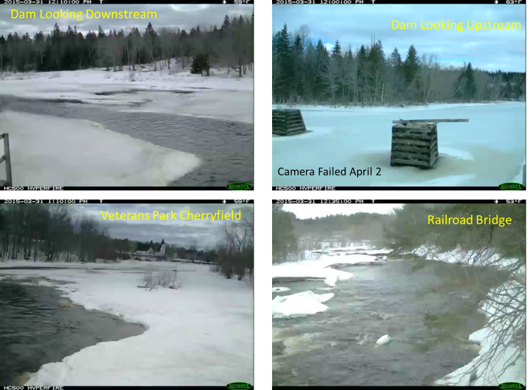
Time lapse information
Pictures taken every 5 minutes from 6AM to 7PM
Playback 30 frames/sec Duration 2:25 (145 sec)

Slide 22
On next slide Click each photo (video) to start If you click each video quickly, the videos will be very closely time sync'd Duration 2:25 (145 seconds)

Slide 23
Dam Looking Downstream
Dam Looking Upstream
Camera Failed April 2
Veterans Park Cherryfield
Railroad Bridge

